Slide 1


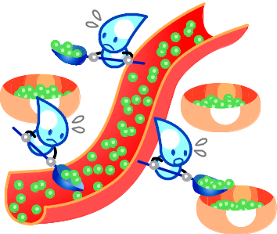
What is diabetes mellitus?
★The keyword is “Insulin”!
Diabetes mellitus (DM) is a disease in which the hormone called “insulin” is not made enough or does not function well in your body. This leads to high levels of glucose (hyperglycemia) in the blood (blood glucose; BG) that lasts for a prolonged period of time.
★What is insulin?
“Insulin” is a hormone produced by the pancreas and its role is to regulate and keep your blood glucose at a normal level. “Insulin” is the only hormone available in the body that helps to reduce BG level.
“Insulin” helps transport glucose from the blood into the cells of your body, and this is how blood glucose level is reduced.
At times, blood glucose cannot be maintained at a normal level due to lack of insulin or its suboptimal action which can be caused by some problem or other reasons. You can see how an important role “insulin” has in maintaining the BG level.
Normal
Hyperglycemia
BG level
Blood glucose
Insulin
When your BG level is high, your body may be in a temporarily condition in which insulin is less effective or active to reduce BG compared to your normal status.

Slide 2




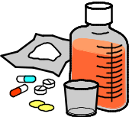

★Should I be afraid of diabetes? Beware of its Complications!
When high blood glucose level is left untreated for a long time, it can make the blood vessels fragile, leading to cause a wide range of complications.
These complications are divided mainly into two categories (affecting small blood vessels /affecting large blood vessels).
In managing your diabetes, it is very important to delay the onset or progression of these complications. Again, since any hyperglycemic state will promote the onset/progression of these complications, it is crucial to constantly maintain good blood glucose levels.
★3 Core Approaches to manage your diabetes
There are 3 core approaches to maintain a good glucose level. Each and every approach is important and none of them can replace others. The key to good management is to make these approaches part of your everyday life.
Cerebral infarction
Retinopathy
Myocardial infarction
Nephropathy
Neuropathy
Peripheral artery disease
Healthy Eating
Medication
Being Active

Slide 3
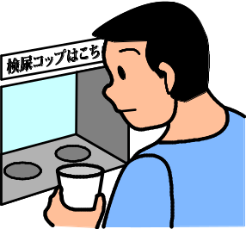

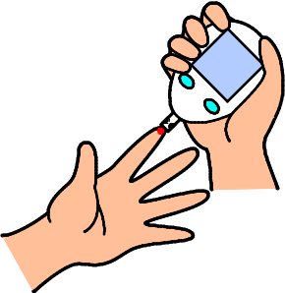
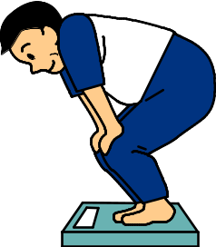
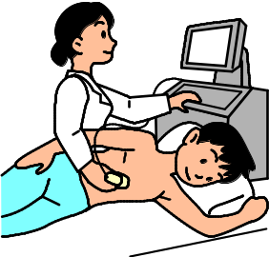


★ Measurements and tests help you manage your diabetes
Regular Measuring and Testing plays a great role in knowing your diabetes condition.
  Body Weight
  Blood Pressure
  Self Measurement of Blood Glucose (SMBG) when using injections
  others
These measurements/ test results guide you in the 3 Core Approaches; Healthy eating, Being Active, and can help finding Medication that will suit you.
It is good to learn what kind and for what purpose these measurements and tests are for.
After you take a test or get measured, be sure you get good explanation of these results from your doctor or heath care team.
Knowing what the exams are for, and your results will help you better understand and manage your diabetes and its treatments.
Urine test
Fundus examination
BG measurement
(SMBG)
Measuring
Body weight
Ultrasound examination
Measuring
Blood pressure
Electrocardiogram

