Slide 1

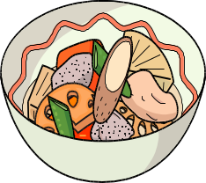
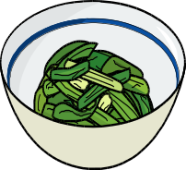
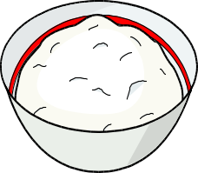
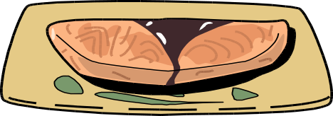







Balancing your Meal
〜staple food, main and side dishes〜
【Side dishes】
Vegetables, seaweeds, mushrooms, etc. i.e.,
food rich in vitamins, minerals, and dietary fibers.
Include in every meal
【Staple food】
Rice, bread, noodles, etc. i.e., food rich mainly in carbohydrates
【Main dishes】
Meat, fish, eggs, Tofu, etc. i.e.,
food rich in proteins and lipids
＊If you have nephropathy, you might need to reduce the amount of protein. Please discuss with your doctor.
You can also take dairy products or fruits as snacks.
Include ONCE each day
【Dairy products】
Food rich in proteins and lipids
(a glass of milk or a cup of yogurt
per day may serve as a guide)
【Fruits】
rich in carbohydrates
and dietary fibers
【Soups ・ Japanese pickles】
Limit your intake of these to 1 dish per day
from either category, as they contain a high amount of salt.
【Lipids】
Limit your intake of deep-fried foods to once or twice a week,
as they contain a high amount of energy. Also, be careful
about the amount of oils or dressings you use on a daily basis.

Slide 2



Tips on reducing salt intake
1. Limit to one cup of miso or other kinds of soup per day.
Chunky soups are favorable (e.g., containing chunks of vegetables, etc.).
2. Do not drink all of the soup when eating noodles.
3. Limit to one small plate of pickles per day (e.g., Japanese pickles),
with no soy sauce.
4. When using soy sauce, dip your food lightly, rather than pouring it on.
5. Know which food include lots of salt and adjust the amount and
frequency of intake.
Cooking tips on bringing out “UMAMI” (savory taste )
★Using sour taste
Sour tastes are; Vinegar, lemon juice, Yuzu, Sudachi, and Kabosu juices.
★ Using spices and pot herbs
Spices include peppers, curry powders, mustards, grated wasabi, and chili peppers.
Pot herbs include Japanese basils, gingers, onions, cibol,
Japanese (myoga) ginger, Japanese honewort, sesames, and laver.
★ Using “dashi” soup stock and “umami”
“Dashi” soup stock helps reduce salt intake and can be made with dried
bonito flakes, dried kelp, dried small fish or dried mushrooms.
Be careful when using commercially available “dashi” granulated powders,
as they may contain a high amount of salt.
★ Using “dashi” and soy sauce combinations
Use a 2:1 soy sauce/“dashi” combination or a Su (vinegar)-soy sauce combination.
★ Using a variety of cooking methods
Char food lightly or use finishing oils for a tasty flavor.
Instead of seasoning your food too highly before cooking, finish it with seasoning applied to the surface.
★ Using fresh foodstuffs
Make the best use of the flavor of the ingredients while they are fresh.
★ Using salt selectively
Instead of making all dishes lightly seasoned, using salt only in some of the main
dishes will make you feel more satisfied.
★ Eat your meals at their appropriate temperature
Eating hot foods while they are still warm and cold foods while they are still cold,
will make you feel more satisfied.

