Slide 1

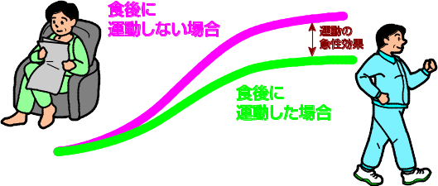
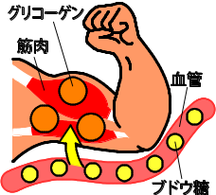
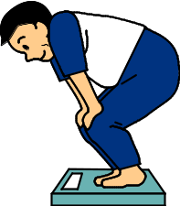

Keys to successful exercise therapy
No exercise
after meals
★Advantages of having regular exercise:
・Helping reduce BG
Exercise helps promote consumption of glucose as the energy source
and is particularly effective when performed within 1 or 2 hours after meals.
・Making glycemic control easier
Exercise therapy promotes muscular uptake of glucose, which, in turn,
helps reduce in BG.
・Helping reduce body weight
Exercise therapy promotes consumption of energy, which,
in turn, helps reduce or maintain body weight.
・Enhancing cardiopulmonary function
Exercise therapy helps improve circulation and lower blood pressure,
which, in turn, helps prevent DM complications.
・Increasing “beneficial” cholesterol
Exercise therapy helps increase “beneficial” cholesterol (HDL cholesterol )and thereby prevent atherosclerosis (tightening or stiffening of your arteries).
・Other benefits
Exercise therapy also helps build your muscles,
make it easier for you to move, and increase
your physical activity. Moreover, it helps strengthen
your bones and relieve your stress.
Acute effect of
exercise
Exercise
after meals
glycogen
muscle
vessel
glucose
It is important that you continue with exercise therapy comfortably, pleasantly, and regularly.★
30 to 60 minutes a day

Slide 2
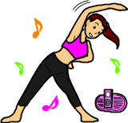
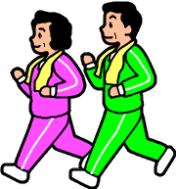
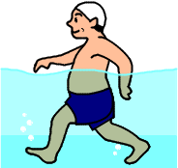
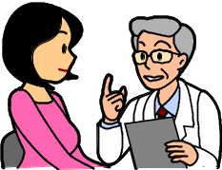
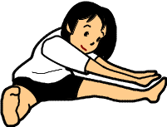
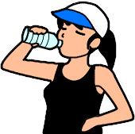
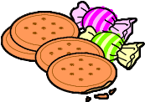
★ Points to keep in mind in doing exercises
★ What are important for exercise therapy for diabetic patients
It is generally accepted that aerobic exercise and muscle (resistance) training are effectively combined in exercise therapy.
・Aerobic exercise → at a comfortable pace that you are still able to chat.
・Muscle training → intended to help increase your muscle strength and mass.
Walking or
slow jogging
Radio gymnastics
Swimming
or wading
(water walking)
Squats using chairs
Calf workouts
Start with low-impact exercises!
Be sure to check with your doctor first before starting exercises
Some patients with complications or insufficient glycemic
control might as well refrain from exercises.
Do not forget to do a warm-up and a cool-down before and after an exercise.
Be prepared for unexpected injuries and accidents.
Do not push yourself too much.
Refrain from exercises when you feel ill or in poor health.
Be sure to remain hydrated and shielded from sunlight.
Take this to heart particularly in the summertime.
Beware of hypoglycemia when under pharmacotherapy. 血糖 Be sure to take appropriate measures against potential hypoglycemia, e.g., self-monitoring BG and having dietary supplements ready for use.

