Slide 1

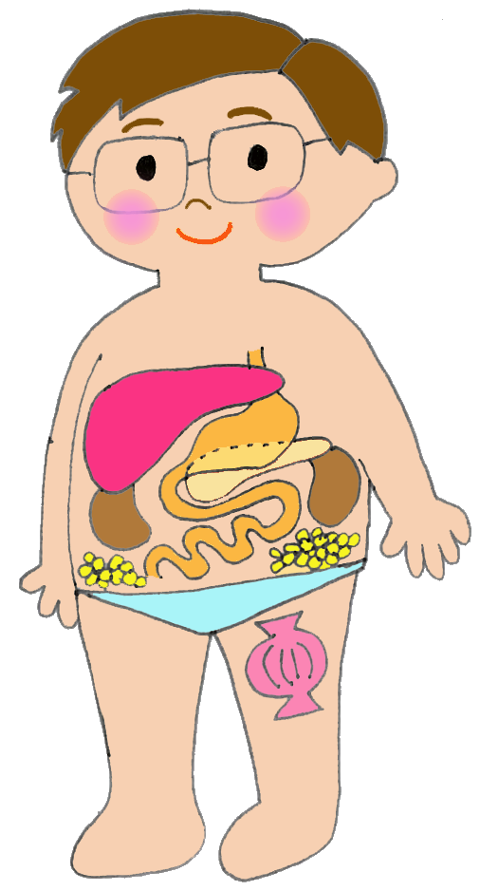
Oral medications for DM
Biguanides
 Biguanides reduce glucose production by the liver; it also reduces glucose uptake and improves insulin action in the skeletal muscle.
 Side effects: diarrhea, nausea, etc.
*Side effects which are
relatively common are written here.
Thiazolidinediones (TZDs)
 TZs acts on the adipose tissue, skeletal muscle and liver to improve insulin action in the body.
 Side effects: edema (swelling), weight gain, etc.
Name of the drug: ______________
Name of the drug: ______________
Sulfonylureas (SUs)
 SUs promotes secretion of insulin from the pancreas.
 Side effects: hypoglycemia, weight gain, etc.
Glinides
 Glinides promotes insulin secretion for a short time and improves hyperglycemia after meals. (Take at the start of each meal for maximal effect )
 Side effects: hypoglycemia, etc.
Name of the drug: ______________
Name of the drug: ______________
DPP-4 inhibitors (DPP4i)
 DPP4i enhances the action of the hormones called “incretins” that are known to act on the pancreas.
 Side effects: hypoglycemia (particularly when used in combination with an SU or insulin), etc.
SGLT-2 inhibitors (SGLT2i)
 SGLT2i inhibits tubular glucose reuptake and reduces blood glucose.
 Side effects: dehydration, urinary/genital infection, etc.
Name of the drug: ______________
Name of the drug: ______________
GLP-1 agonist
○GLP-1 promotes secretion of insulin from the pancreas. (Take before your first meal with water less than 120ml. DO NOT eat or drink for 30 minutes after taking it.)
 Side effects: hypoglycemia (particularly when used in combination with an SU or insulin), etc.
α-glucosidase inhibitors (aGI)
○aGI delays the digestion and absorption of carbohydrates through the small intestine and improves hyperglycemia after meals
(Take at the start of each meal for maximal effect )
 Side effects : increased flatulence, gas, diarrhea, etc.
Imeglimin
 Imeglimin promotes insulin secretion from the pancreas and improves insulin action in the skeletal muscle and liver.
 Side effects: hypoglycemia, nausea, diarrhea, etc.
Name of the drug: ______________
Name of the drug: ______________
Name of the drug: ______________

