Slide 1


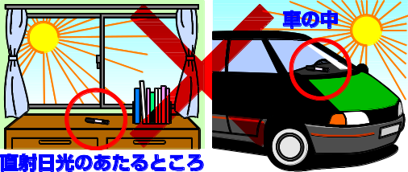
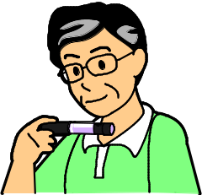
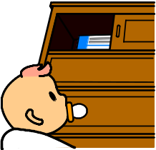
How to store injectable medications (insulin/GLP-1 receptor agonists)
★ It is vitally important that injectable medications be stored under conditions of controlled room temperature.★
★ How to store the opened injectable medications
Store the injectable medications currently in use at room temperature (less than 30 °C Celsius / 86 °F Fahrenheit).
Store these medications away from direct sunlight or excessive heat.
Prevent these medications from freezing.
Store the medications with their needles removed.
In a car
in direct sunlight
★How to store unopened injectable medications
Store unopened medications in a refrigerator (2-8 °C Celsius / 35.6-46.4 °F Fahrenheit).
Store these medications away from the refrigerator evaporator fans in a horizontally position.
Once frozen, any injectable medication is not to be used.
★Note the expiration dates on your medications
The expiration rate is described on the syringe pen or the outer side of its package.
★Be sure not to leave injectable medications in plain sight
Care should be taken to store your injectable medications out of reach of others or children.

