Slide 1


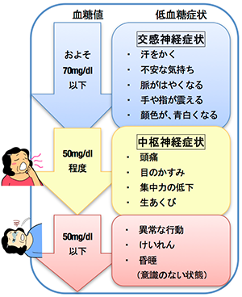

What is hypoglycemia
(low blood glucose) ?
★What is hypoglycemia (low blood glucose) ?
The human body is designed to ensure that BG is maintained at a steady level as the energy source required for its function. Despite this, the BG level may be found to be lower than usual due to some cause. As a rule, when the body tries to elevate BG when it falls below 70 mg/dL, symptoms occur specifically in association with this process and are called the symptoms of “hypoglycemia”. You need to be aware of this process and watch for any symptoms of hyperglycemia, which may occur with BG > 70 mg/dL or, conversely, may not occur with BG < 70 mg/dL.
★Symptoms of hypoglycemia
Symptoms of hypoglycemia include those listed in the
figure. Be aware that if you experience hypoglycemia
frequently you may have no subjective symptoms associated
with low blood glucose. This is “hypoglycemia unawareness”.
★ Causes of hypoglycemia
Medication or insulin overdose
Meals taken at different times or in different amounts
than usual
Insufficient carbohydrate intake
Falls in BG during or after a high-impact/long-lasting exercise
Falls in BG during drinking or bathing
Heightened efficacy of medications associated with successful lifestyle modification
DO NOT panic if you experience a hypoglycemic episode, as it is likely to occur to anybody being treated for DM and can be alleviated if appropriately treated.
BG level
Symptoms
About < 70 mg/dL
Sympathetic nerve symptoms
Perspiration
Anxiety
Bounding pulse
Trembling
Facial pallor
About 50 mg/dL
Central nervous system symptoms
Headache
Blurred vision
Decreased concentration
Yawning
< 50 mg/dL
Abnormal behavior
Convulsion
Coma
(unconsciousness)

Slide 2
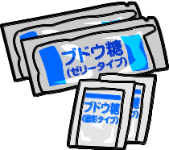
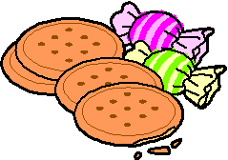

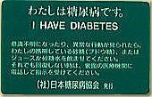
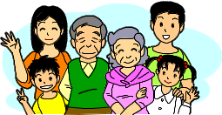
★How to deal with your hypoglycemic episodes
Always carry with you glucose or some other option ready for hypoglycemia.
Take 10 g of glucose or 150-200 ml of water containing glucose
whenever you feel you have some symptom of hypoglycemia.
Take a meal, as you should, when you have hypoglycemia at a meal time.
Take a carbohydrate-rich meal soon after remission of your symptom.
Take carbohydrates equivalent to 80 kcal if you have 1 hour or more before your next
meal.
Do not use chocolate, among the sweets, to deal with your hypoglycemia, as it is likely to be absorbed only slowly.
Be careful not to take too much glucose, as this may lead to an acute
increase in BG later.
Be sure to take pure glucose if you are taking an α-glucosidase inhibitor, as this drug delays carbohydrate digestion and absorption.
★What to do to prevent recurrent or severe hypoglycemia
Learn to take your medications and inject your insulin properly.
Be sure to carry with you glucose at all times, so you can deal with
hypoglycemic episodes as they occur.
Try to live an orderly life.
Tell your doctor about any hypoglycemic episode or symptom suggestive of hypoglycemia you have had.
Familiarize your family or those around you with the symptoms of hypoglycemia and how to deal with hypoglycemic episodes, so you can depend on them for help in dealing with your hypoglycemic episodes.
Carry with you your diabetes card at all times, so those around you
can take care of you, as required, during your hypoglycemic episodes.
Drivers should have plenty of glucose-rich foods in their cars at all times.
Do not hesitate to ask your doctor or nurse if you have any concern about
dealing with your hypoglycemic episodes.

