Slide 1

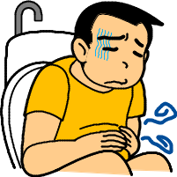
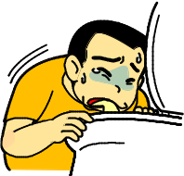
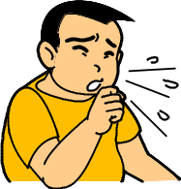
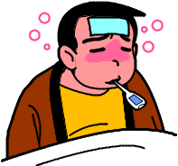
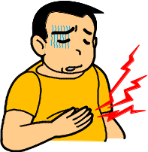

How are you supposed to deal with your Sick Day?
★What is a Sick Day?
A Sick Day is defined as one in which you are sick with a cold, the flu or diarrhea or nausea that makes it difficult for you to take meals.
As you are likely to have erratic glycemic control on a Sick Day, an appropriate measure needs to be taken to deal with it as soon as possible.
You are likely to have high BG due to the secretion of stress hormones and the associated decrease in insulin action during a Sick Day.
Conversely, being unable to eat, you are likely to have hypoglycemia.
Diarrhea Vomiting Cough/cold Fever Abdominal pain
★How to deal with your Sick Day
1. Keep warm and rest.
This basic coping method is effective in itself.
This helps to prevent exhaustion and promote recovery.
2. Take adequate meals, water and minerals.
Take precautions against dehydration likely to result from fever, diarrhea or vomiting.
This measure also helps to keep your symptoms from worsening.
3. Contact/visit your hospital as soon as possible
When you cannot take any meals due to diarrhea or vomiting
When you have severe abdominal pain
When you continue to have a high fever (38°Celcius/100.4℉ Fahrenheit or higher)
4. Check your condition as often as you can.
Measure your BG, body temperature, blood pressure, dietary/water intake, and subjective symptoms.
Closely monitor your condition on a sick day, and your doctor will be able to give detailed instructions on how to deal with your health problems.
Be sure to have your Sick Day plan determined beforehand in consultation with your doctor!

