Slide 1

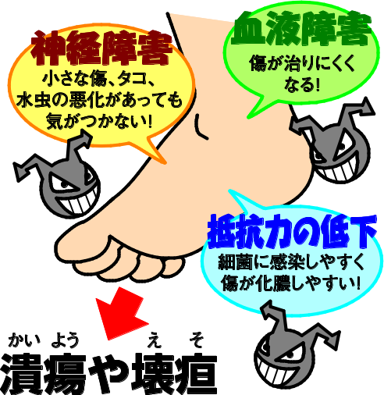
Diabetes Foot Care
Lack of good glycemic control leads to:
Makes you less sensitive to pain, then less aware of any injury or burn, which, in turn, may be left untreated.
Delayed detection of injury/ burn
Nerve damage
(Neuropathy)
Impaired
immune system
Leads to festering/delayed healing of your wound
Infection
Leads to less blood flow in the limbs (e.g., feet), failure to provide the amount of blood or oxygen required for the cells
Impaired blood flow
Ulceration
Gangrene
Nerve damage makes you less aware of any small injury, callosity, or worsening of athlete’s foot!
Impaired blood flow makes wound healing difficult!
Amputation
Impaired immune system makes you more susceptible to bacterial infection and wound festering!
Ulceration or Gangrene

Slide 2

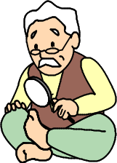




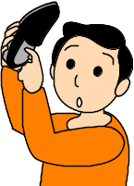
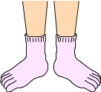

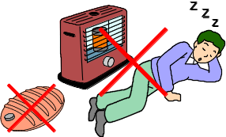
Points to be kept in mind
to protect your feet
★ Examine your feet every day.
Use a mirror to examine the parts of your feet you cannot see directly or ask your family to examine them.
★ Wash your feet clean and dry them well every day.
Wash between your toes thoroughly clean.
First make a lather with your soap first and then wash your feet gently.
Dry your feet well after cleaning them.
Use cream to moisturize your feet when too dry. (Do not apply moisturizing cream between the toes)
★ Be careful not to clip your nails too short.
Avoid cutting your nails too short.
Be careful not to trim the ingrowing edges too much.
★ Be sure to wear shoes that fit your feet.
Beware of shoe sores.
Choose a pair of shoes that fit your feet perfectly.
Make sure that your shoes contain no foreign object before putting them on.
★ Do not put shoes on your bare feet; put on socks to protect your feet.
This helps prevent athlete’s foot and protect your feet.
You might like to use five-finger socks.
★Be careful not to get burned.
Beware of low-temperature burns associated with the use of hot water bottles or disposable body warmers.

