Slide 1

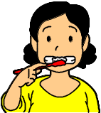
Diabetes and Oral Health
★ What is periodontal disease?
Periodontal disease is a disease of the tooth-supporting tissue (gums); it is a chronic disease associated with bacterial colonization of the periodontal pocket environment.
Unlike caries, periodontal disease is not associated with pain and tends to be left untreated, become more severe, and lead to failure of the tooth-supporting tissue thus causing tooth loss.
Tooth loss is likely to lead to difficulties with chewing, adversely affect the internal organs, and make it difficult to enjoy foods and conversations.
★ Relationship between diabetes and periodontal disease
Individuals with high BG is likely to become more susceptible not merely to infection but to periodontal disease.
Conversely, individuals with diabetes complicated by periodontal disease tend to have high BG and less favorable glycemic control. Moreover, those with impaired oral health are not easily practicing diet therapy as an important component of diabetes treatment.
★ Prevention and treatment of periodontal disease
Tooth brushing comes first.
Plaque control is crucial to prevention of periodontal disease. Dental plaque is composed of oral debris and aggregates of bacteria growing on the surfaces of the teeth, and, if left unremoved, causes periodontal disease and turn into tartar over time, which cannot be removed by mere brushing and requires to be removed at a dentist’s office.
While not necessarily needed for prevention of periodontal disease, the use of toothpaste helps reduce oral odors and keep the teeth white and clean. However, you should not use it too much, as it causes damage to the surfaces of your teeth, while making you feel refreshed and giving you the false impression that you have brushed your teeth well.

Slide 2
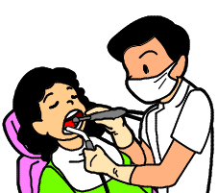
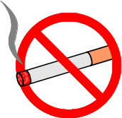


Be sure to clean between the teeth adequately with interdental brushes or dental floss.
Ideally, you should brush your teeth after each meal, but, if this is not feasible or practicable, brush your teeth well once a day before bedtime.
If you have false teeth (dentures), remove and brush them well as you would your own teeth.
Consult a dentist regularly
You need to consult a dentist to have your periodontal disease treated.
You need to consult a dentist 3 to 4 times a year on a regular basis. Specifically, follow the dentist’s instructions on how to deal with your problems. It is also important that you receive instructions from the dentist on how to brush your teeth appropriately. When you consult a dentist for the first time, be sure to tell the dentist that you have diabetes and what kind of treatment you are receiving.
Other considerations for lifestyle modification
It is also important that you stop smoking. Impaired blood flow due to smoking is associated with decreases not only in nutrition
and oxygen supply to the tissues but in resistance to bacteria.
Review your current eating habits. Note that between-meal
or sweet eating places you at high risk of periodontal disease.
Do not use toothpicks; they tend to cause
damage to the gums and widen the interdental spaces.
Reports show that glycemic control has improved after the cure of periodontal disease. Try to maintain your oral health, so you can have an enjoyable life!

